Slide 1
Advance Analytics

Slide 2
Example of Raw Data
The weekly sales (‘000’ units) of a product in a region over the past year(2021) are :
52, 61, 59,55,63,70,59,77,81,83,69,91,73
83,90,81,77,77,74,65,33,77,64,49,49,52
50,45,42,46,39,29,38,41,43,23,26,27,22
29,31,29,31,30,30,29,40,44,45,46,47,53
Suppose you present this set of data as it to the General Manager (Sales).??????

Slide 3
Sales
Mean | 52.46153846
Standard Error | 2.719054813
Median | 49.5
Mode | 77
Standard Deviation | 19.6073831
Sample Variance | 384.4494721
Kurtosis | -1.052025713
Skewness | 0.282855754
Range | 69
Minimum | 22
Maximum | 91
Sum | 2728
Count | 52
Confidence Level(95.0%) | 5.4587302

Slide 4
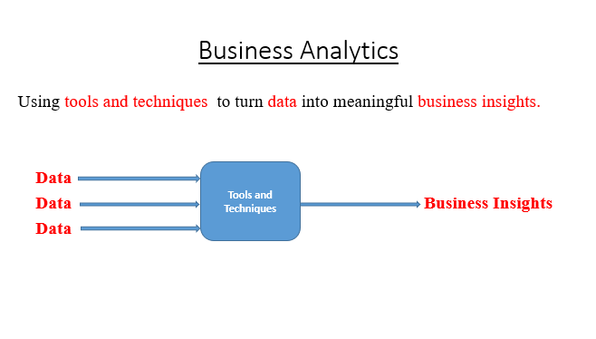
Business Analytics

Slide 5
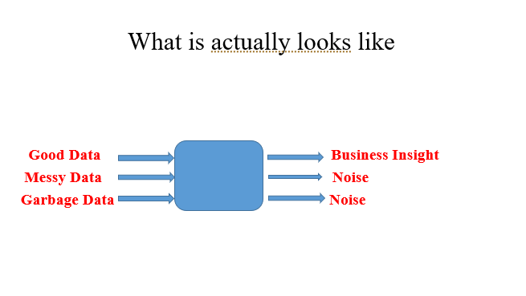
Business Analytics
Tools and Techniques

Slide 6
A Note about Buzz Words..
There are lots of Buzz words that closely resemble business analytics.
Business Intelligence
Data Science
Decision Science

Slide 7
Challenges..
Data often needs lots of cleaning!
This can be sometimes the most frustrating task.
Data is rarely is in the form that you need it.

Slide 8
Challenges..
Data is much more unstructured !
It does not all come from relational databases or spreadsheets, pdf, mp3, jpg, Xls, doc, etc

Slide 9
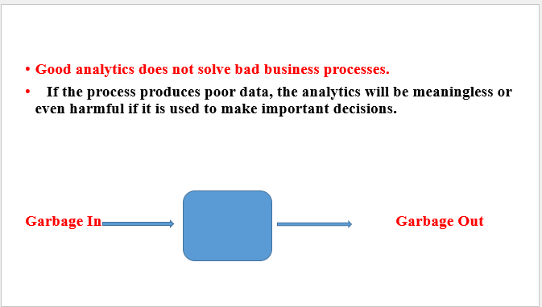
Challenges..

Slide 10
How to do Good Research and collection of relevant Data?
The good research and data must have
1. Validity
2. Reliability
3. Sensitivity
Validity- is the ability of the measure to measure what it is supposed to measure
Reliability- is the ability to get consistent results when same measure is repeated.
Sensitivity- is the ability of the measure to measure variability in responses.

Slide 11
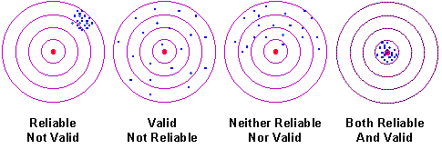
Reliability & Validity

Slide 12
Business Analytics
Business Analytics is the use of data, information technology, statistical analysis, quantitative methods, and mathematical or computer-based models to help managers gain improved insight about their business operations and make better , fact-based decisions.
Business Analysis is “ a process of transforming data into actions through analysis and insights in the context of organizational decision making and problem solving.
Business Analytics is supported by various tools as, Microsoft Excel and Excel Add-ins, statistical packages as SPSS, SAS, Minitab, R-Programming etc.

Slide 13
Perspective of Business Analytics
Business Intelligence/ Information Systems
Data Mining
Statistics
Visualization
Simulation & Risk
What If
Modeling and Optimization

Slide 14
Statistics: By “Statistics” we mean methods specially adapted to the collection, analysis and interpretation of data for making effective decisions in all functional areas of management.

Slide 15
Business Intelligence/Information Systems:
The process of gathering information in the field of business. It can be described as the process of enhancing data into information and then into knowledge. Business intelligence is carried out to gain sustainable competitive advantage, and is a valuable core competence in some instances.

Slide 16
Data Mining:
Data Mining is focused on better understanding characteristics and patterns among variables in large database using a variety of statistical and analytical tools.
Many standard statistical tools as well as more advanced ones are used extensively in data Mining.

Slide 17
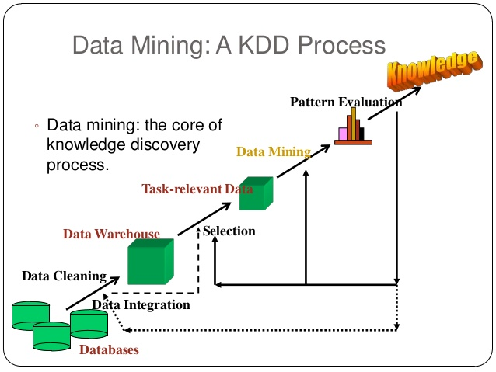

Slide 18
Simulation and Risk Analysis:
It relies on spreadsheet models and statistical analysis to examine the impacts of uncertainty in the estimates and their potential interaction with one another on the output variable of interest.

Slide 19
What if Analysis:
Spreadsheets and formal models allow one to manipulate data to perform, what if analysis- how specific combinations of inputs that reflect key assumptions will affect model output.
What if analysis is also used to asses the sensitivity of optimization models to changes in data inputs and provide better insight for making good decisions.

Slide 20
Visualization: Data visualization is the presentation of data in a pictorial or graphical format. It enables decision makers to see analytics presented visually, so they can grasp difficult concepts or identify new patterns. With interactive visualization, you can take the concept a step further by using technology to drill down into charts and graphs for more detail, interactively changing what data you see and how it’s processed.

Slide 21
Modeling and Optimization: It is a technique for translating real programs into mathematics, spreadsheets or other computer languages, and using them to find the best(optimal) solutions and decisions.

Slide 22
Example:
You wish to produce two products (1) Walkman AM/FM/Cassette and (2) Watch-TV
Walkman takes 4 hours of electronic work and 2 hours assembly
Watch-TV takes 3 hours electronic work and 1 hour assembly
There are 240 hours of electronic work time and 100 hours of assembly time available
Profit on a Walkman is Rs.7; profit on a Watch-TV Rs.5

Slide 23
Scope of Business Analytics
Descriptive Analytics
Predictive Analytics
Prescriptive Analytics

Slide 24
1. Descriptive Analytics: is concerned with data summarization ,graphs/charts, and Tables . It processes raw data into information and information is key to decision making.
This focuses on historical reporting, addressing such questions as:
How many loan apps were taken each of the past 12 months?
What was the total cycle time from app to close?
Example: Mean, Median, Mode, Kurtosis, Skweness

Slide 25
2. Predictive Analytics: Predictive modeling use mathematical , spreadsheet, and statistical models, and address questions such as:
Impact of Advertisement on sales.
Will a given process change reduce cycle time.

Slide 26
3.Prescriptive Analytics: uses optimization to identify the best alternatives to minimize or maximum objectives.
What is the best way of shipping goods from the factory to the warehouses?
How much we should produce to maximize the profit?

Slide 27
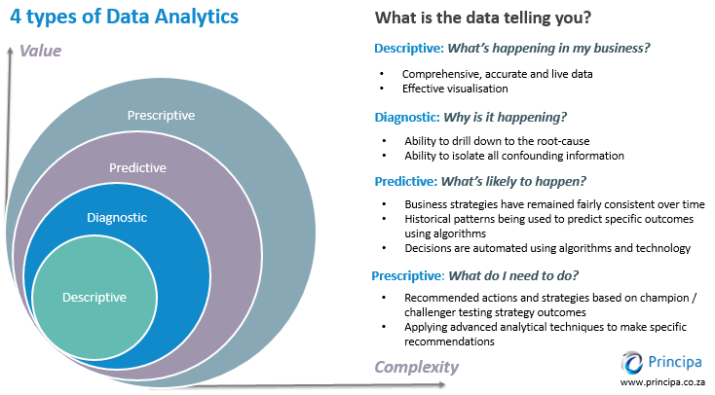
Scope of Business Analytics

Slide 28
Some Key Terms and Definitions
Population: Populations is the collection of all possible observations of a specified characteristic of interest. All students taking the statistics course in a business school is an example of population.
Sample: sample is a subset of the population. Suppose you want to select a team of 20 students from 200 students I an MBA program for participating in a management quiz. The total number of students 200 is the population . 20 students selected for the quiz is the sample.

Slide 29
Continued…
Parameter: A population characteristic of interest is known as parameter. For example , you want to have some idea about the income level of a particular class of people. The average income of this entire class of people is known as parameter.
Statistic: A statistic is a type of average that is based on a sample. It is used to make inferences about the population parameter.

Slide 30
Types of Data
Qualitative Data
Quantitative Data

Slide 31
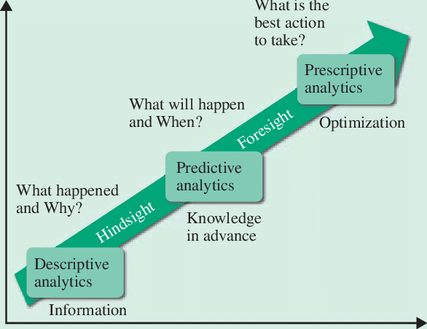
Evolution of Analytics

Slide 32
Evolution of Analytics

Slide 33
Steps involved in Data Analytics/Business Analytics
a) Decide on the objectives: In your data analysis process, you must begin with the right set of questions. Some examples include: How can we reduce production costs without sacrificing quality? What are some ways to increase sales opportunities with our current resources? Do customers view our brand in a favorable way? etc.
b) Set measurement priorities: This step involves processes to identify what to measure and how to measure? For example, should you perform your analysis weekly, monthly or annually? What is your unit of measure? What factors should be included in your analysis? etc.

Slide 34
Continued..
Data collection: Data Collection is the process of collecting information on targeted variables for your analysis. In this step, the emphasis is to ensure collecting accurate and honest data. Thus, before you start your hunt for collecting new data, find what information could be collected from existing data sources.
Data cleaning: Data Cleaning is the process of preventing and correcting errors in data. It includes steps such as structuring the data as required for the relevant analysis tools, removing duplicate values, identifying outliers in data, etc

Slide 35
Continued..
Analysis of data: Various data analysis techniques can be used to understand, interpret, and derive conclusions based on the requirements. . Tools like Microsoft Excel, R, Python, Tableau, etc. can be used for performing analysis.
Interpreting the results: Does the analysis answer your objectives? Does the analysis help you defend against any objections? Is there any limitation on your conclusions, any angles you haven’t considered? If your interpretation of the data holds up, under all of these questions and considerations, then you likely have come to a productive conclusion. Create a report of your analysis in a format as required by stakeholders for business decisions. The feedback from stakeholders might result in additional analysis

Slide 36
Hiring trends in Data Science
In August 2020, India contributed to 9.8% of the total global Analytics job openings. This is a significant jump from the figure of 7.2% of total global job openings in January 2020.
Almost 98% (97.8%) of Analytics jobs advertised in India are full-time, signifying the strengthening of the Indian Analytics hiring market.
Just 2% of the jobs form part-time, internship or contractual jobs – similar to the trend of January 2020 and the overall trend of 2019, when an approximate 97.5% full-time and 2.5% part-time jobs were advertised.

Slide 37
Continued..
The Banking sector was one of the early adopters of analytics across operations. This sector continues to be the biggest influencer in the analytics job market with 35% of all Analytics jobs. Other sectors contributing to analytics job market in India significantly are, Pharma and Healthcare Industry, e-commerce, energy & utilities.

Slide 38
Continued..
In terms of cities, Bengaluru once again accounts for the maximum proportion of open jobs, contributing around 23% of Analytics jobs in India.
Delhi/ NCR comes second contributing 20% of the analytics jobs in India, down from 21% in January 2020, and from 22% a year ago. Approximately 15% of the Analytics jobs are advertised for Mumbai. This is a marginal increase from 14% in January 2020 and a marginal decrease from 14.7% last year.

Slide 39
Continued..
The demand for Python professionals continues to remain the highest. Almost 27% of advertised jobs require Python as a core skill, which was 18.5% at the beginning of the year 2020. R comes third with 10% of all analytics jobs requiring R as a core skill.
The median salary advertised across Analytics jobs in India is 9.5 Lakhs per annum. 13.1% of all advertised jobs in August 2020 offer a salary greater than 15 Lakhs per annum. Close to 10% of all advertised jobs in August 2020 offer a salary between 15 to 25 Lakhs per annum.

Slide 40
How-to do-Good Research and collection of relevant Data?
Good research and data must have
1. Validity
2. Reliability
Validity- is the ability of the measure to measure what it is supposed to measure
Reliability- is the ability to get consistent results when the same measure is repeated.

Slide 41
Data Science Profiles
Data Scientist: A data scientist is probably one of the hottest job titles that you can put on your business card. The core skills required to be a data scientist are, Statistics, Programming and a good level of data interpretation and communication.
Data Analyst: The data analyst is the Sherlock Holmes of the data science team. Languages like R, Python, SQL, and C are elementary to him/her.
Data engineer: The data engineer often has a background in software engineering and loves to play around with databases and large-scale processing systems. The core skills required to be a data engineer are Programming, Database Management, and Big data framework.

Slide 42
Continued..
Data Architect: The person in this role creates the blueprints for data management systems to integrate, centralize, protect and maintain the data sources. The data architect masters technologies like Hive, Pig, and Spark, and needs to be on top of every new innovation in the industry.

Slide 43
Useful Tools in Data Science
1. Database tools: which are used to store the data
Database Tools: SQL, MongoDB, MySQL, Oracle RDBMS
2. Data transformation tools: which are very useful to transform raw data into meaningful information
Data transformation Tools: Microsoft Excel, Python, R Language, Apache Spark
3. Data Modeling Tools: These are very useful to build predictive models using machine learning algorithms.
Data Modeling Tools: Scikit-Learn, TensorFlow, Weka:, Apache Spark,
4. Data Modeling Tools in Visualization: These are very useful in data visualization.
Data Modeling Tools in Visualization: Tableau, Power BI, Microsoft Excel, R, and Python Language

Slide 44
Reliability and Validity

Slide 45
Types of Data
Qualitative Data
Quantitative Data

Slide 46
Metrics and Data Classification
Nominal Scale
Ordinal Scale
Interval Scale
Ratio Scale

Slide 47
Nominal scale
When numbers assigned to objects serve as labels for identification or categorization, then such numbers are in nominal scale. Such numbers have no quantitative meaning.
For e.g.
Male = 1
Female = 2
The only permissible operation on such numbers is counting. %, mode, chi-square, and binomial tests can be performed on such data.

Slide 48
Ordinal scale
When assigned numbers to indicate the relation between entities in terms of greater than, equal, or less than but do not state how much greater than or less than, then the scale is called ordinal scale.
For e.g. Ranks
Rank following brands of TV on sound quality:
Rank
Akai ------------
Videocon -----------
Samsung -----------
This means we cannot conclude about the difference between values of two objects. We can calculate median, quartiles, deciles, percentiles & rank order correlation.

Slide 49
Interval scale
When assigned numbers are such that the difference in numbers is valid but not ratios, then the scale is called interval scale.
In this scale there is no true zero indicating absence of characteristic. For e.g
Temperature
– To what extent do you like the sound quality of SONY TV?
Liked very much 5
Somewhat liked 4
Neither liked nor disliked 3
Somewhat not liked 2
Not liked at all 1
Arithmetic mean, standard deviation, product-moment correlations can be applied to interval scale data.

Slide 50
Ratio scale
When a scale contains absolute zero, it is called ratio scale
All mathematical operations (+,-,*,/) are valid on this data
All statistical techniques can be applied to ratio scale data.

Slide 51
Metrics and Data Classification
Nominal Scale
Ordinal Scale
Interval Scale
Ratio Scale

Slide 52
Nominal scale
When numbers assigned to objects serve as labels for identification or categorization, then such numbers are in nominal scale. Such numbers have no quantitative meaning.
For e.g.
Male = 1
Female = 2
The only permissible operation on such numbers is counting. %, mode, chi-square and binomial tests can be performed on such data.

Slide 53
Ordinal scale
When assigned numbers indicate relation between entities in terms of greater than, equal or less than but do not state how much greater than or less than, then the scale is called ordinal scale.
For e.g. Ranks
Rank following brands of TV on sound quality:
Rank
Akai _____
Videocon _____
Samsung _____
This means we cannot conclude about difference between values of two objects. We can calculate median, quartiles, deciles, percentiles & rank order correlation.

Slide 54
Interval scale
When assigned numbers are such that difference in numbers is valid but not ratios, then the scale is called interval scale.
In this scale there is no true zero indicating absence of characteristic. For e.g
Temperature
– To what extent do you like sound quality of Akai TV?
Liked very much 5
Somewhat liked 4
Neither liked nor disliked 3
Somewhat not liked 2
Not liked at all 1
Arithmetic mean, standard deviation, product-moment correlations can be applied to interval scale data.

Slide 55
Ratio scale
When a scale contains absolute zero, it is called ratio scale
All mathematical operations (+,-,*,/) are valid on this data
All statistical techniques can be applied to ratio scale data.

Slide 56

Primary Scales of Measurement
Scale
Nominal Numbers
Assigned
to Runners
Ordinal Rank Order
of Winners
Interval Performance
Rating on a
0 to 10 Scale
Ratio Time to Finish, in
Seconds
Finish
7
8
3
Finish
Third
place
Second
place
First
place
8.2
9.1
9.6
15.2
14.1
13.4

Slide 57
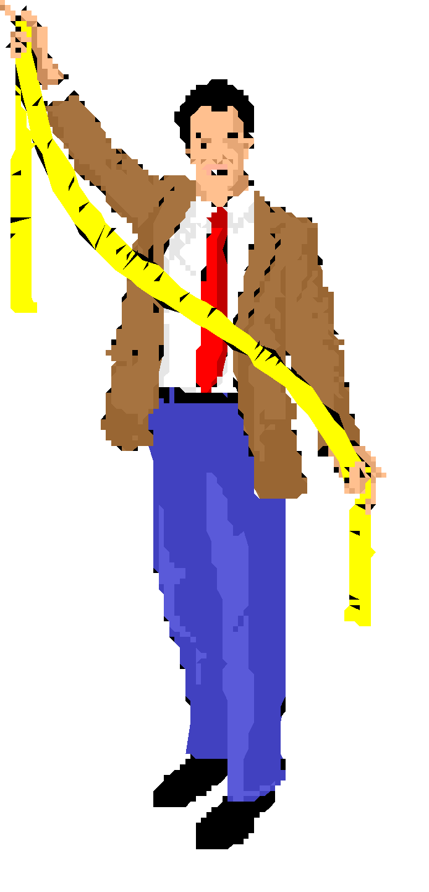

Illustration of Primary Scales of Measurement
Nominal Ordinal Ratio
Scale Scale Scale
Preference $ spent last No. Store Rankings 3 months
1. Lord & Taylor
2. Macy’s
3. Kmart
4. Rich’s
5. J.C. Penney
6. Neiman Marcus
7. Target
8. Saks Fifth Avenue
9. Sears
10.Wal-Mart
Interval Scale
Preference Ratings
1-7 11-17

Slide 58
Sources of Data
Primary Data
Secondary Data

Slide 59
Frequency Distribution
FREQUENCY DISTRIBUTION A grouping of data into mutually exclusive classes showing the number of observations in each class.
A Frequency

Slide 60
Frequency Distribution
Class interval: The class interval is obtained by subtracting the lower limit of a class from the lower limit of the next class.
Class frequency: The number of observations in each class.
Class midpoint: A point that divides a class into two equal parts. This is the average of the upper and lower class limits.

Slide 61
Frequency Table
FREQUENCY TABLE A grouping of qualitative data into mutually exclusive classes showing the number of observations in each class.

Slide 62
Frequency Distribution Table
Class | Frequency
22-32 | 12
32-42 | 5
42-52 | 11
52-62 | 7
62-72 | 5
72-82 | 8
82-92 | 4
Total | 52

Slide 63
Graphical Representation by
Line Diagram
Bar Diagram
Pie Chart
Histogram
Frequency Polygon
Cumulative Distribution Curve

Slide 64
Line Diagram
It is the simplest of all diagrams. Line graphs are simple mathematical graphs that are drawn on the graph paper by plotting the data concerning one variable on the horizontal axis as x-axis and other on the vertical axis i.e y-axis.
Q1. The following data show the number of child birth to 100 families in a hospital in one year . Draw a line diagram:
No. of children | 1 | 2 | 3 | 4 | 5 | 6 | 7 | 8
No. of Families | 2 | 18 | 15 | 10 | 13 | 22 | 9 | 11

Slide 65
Bar Charts
BAR CHART A graph in which the classes are reported on the horizontal axis and the class frequencies on the vertical axis. The class frequencies are proportional to the heights of the bars.

Slide 66
Simple Bar Diagram
Q1. Draw a bar diagram of the procurement of rice (in tons) in an Indian state.
Year | 2010 | 2011 | 2012 | 2013 | 2014 | 2015
Rice in tons | 4500 | 5700 | 6100 | 6500 | 4300 | 7800

Slide 67
Multiple or Grouped Bar Diagram
Q1. Represent the following data by a suitable diagram showing the difference between proceeds and costs. Proceeds and costs of a firm in thousand rupees.
Year | Total proceeds | Total Costs
2011 | 22.0 | 19.5
2012 | 27.3 | 21.7
2013 | 28.2 | 30.0
2014 | 30.3 | 25.6
2015 | 32.7 | 26.1
2016 | 33.3 | 34.2

Slide 68
Sub-Divided or Component Bar Diagram
Q1. Represent the following data of the development expenditure in cr. of central government in India during 2011-12, 2012-13,2013-14 by bar diagram.
Year | Loans and Advances | Capital | Revenue | Total
2011-12 | 8601 | 3787 | 3477 | 15865
2012-13 | 10335 | 4456 | 4036 | 18827
2013-14 | 11549 | 4803 | 3709 | 20061

Slide 69
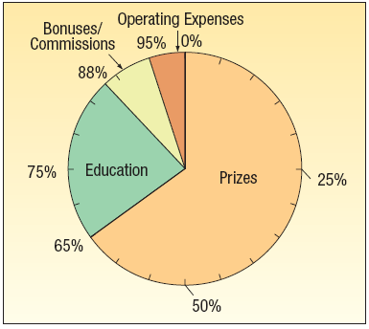
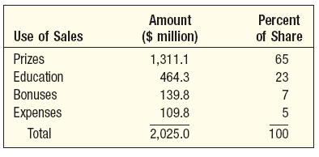
Pie Charts
PIE CHART A chart that shows the proportion or percent that each class represents of the total number of frequencies.

Slide 70
Pie Diagram
Q1. 120 of C-DAC are asked to opt for different specialization . The details of these options are as follows. Represent the below data through pie diagram.
Specialization | No. of Students
Marketing | 6
Finance | 30
HRM | 48
Operations | 12
IT | 24

Slide 71
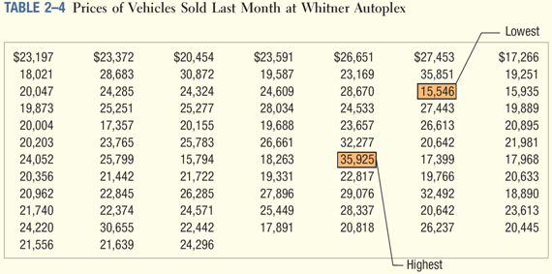
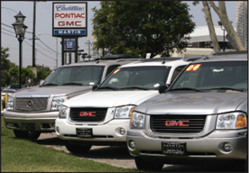
EXAMPLE – Creating a Frequency Distribution Table
Ms. Kathryn Ball of AutoUSA wants to develop tables, charts, and graphs to show the typical selling price on various dealer lots. The table on the right reports only the price of the 80 vehicles sold last month at Whitner Autoplex.

Slide 72
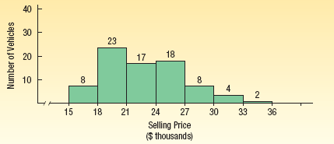
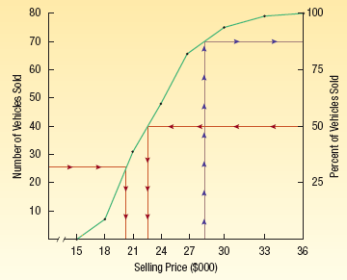
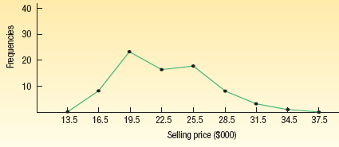
Graphic Presentation of a Frequency Distribution
Histograms
Frequency polygons
Cumulative frequency distributions

Slide 73
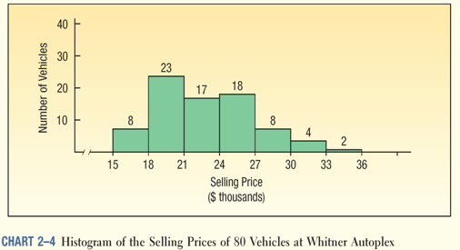
Histogram
HISTOGRAM A graph in which the classes are marked on the horizontal axis and the class frequencies on the vertical axis. The class frequencies are represented by the heights of the bars and the bars are drawn adjacent to each other.

Slide 74
Histogram
Q1. Draw a histogram for the following data.
Marks | 0-10 | 10-20 | 20-30 | 30-40 | 40-50 | 50-60 | 60-70
No. of students | 20 | 30 | 70 | 50 | 40 | 50 | 40

Slide 75
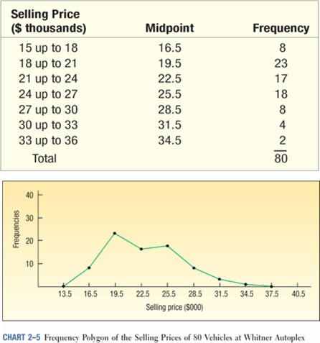
Frequency Polygon
A frequency polygon also shows the shape of a distribution and is similar to a histogram.
It consists of line segments connecting the points formed by the intersections of the class midpoints and the class frequencies.

Slide 76
Frequency Polygon
Q1. Draw a frequency polygon from the Table.
Monthly Wages | No. Of Workers
190-210 | 0
210-230 | 4
230-250 | 7
250-270 | 5
270-290 | 9
290-310 | 5
310-330 | 6
330-350 | 4
350-370 | 0

Slide 77
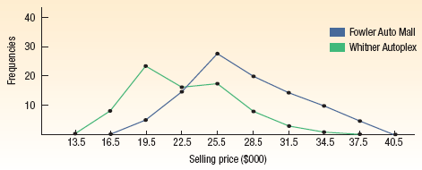
Histogram Versus Frequency Polygon
Both provide a quick picture of the main characteristics of the data (highs, lows, points of concentration, etc.)
The histogram has the advantage of depicting each class as a rectangle, with the height of the rectangular bar representing the number in each class.
The frequency polygon has an advantage over the histogram. It allows us to compare directly two or more frequency distributions.

Slide 78
Cumulative Frequency Curves
Q. 1. Draw a cumulative frequency curve and estimate the number of persons between the ages of 32-42 in the following table.
Age | No. of persons | Cumulative Frequency (Less Than) | Cumulative Frequency (More than)
20-25 | 50 | 50 | 799
25-30 | 70 | 120 | 749
30-35 | 100 | 220 | 679
35-40 | 180 | 400 | 579
40-45 | 150 | 550 | 399
45-50 | 120 | 670 | 249
50-55 | 70 | 740 | 129
55-60 | 59 | 799 | 59

Slide 79
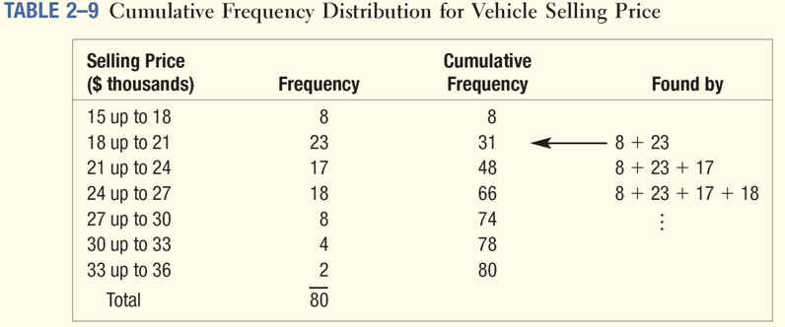
Cumulative Frequency Distribution

Slide 80
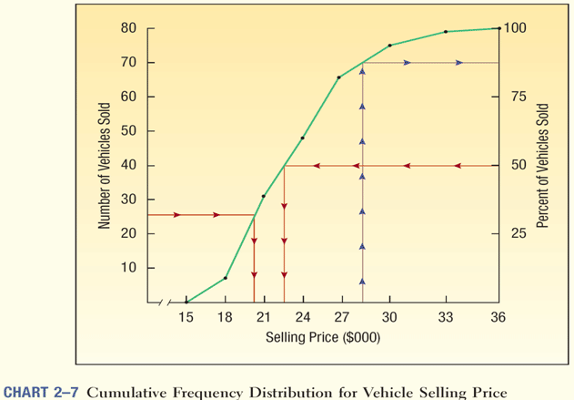
Cumulative Frequency Distribution

Slide 81
Case Study:1: Waiting Time in ATM Counters
A private bank having a number of ATMs in various locations is contemplating to install another ATM at one of its potentially strong business city. As a first step in assessing commercial feasibility, the bank authorities had collected data on the waiting time customer face at the existing ATM counters. One hundred customers were studied and waiting time in minutes each one spent at the counter was recorded. The data are given below:
Waiting Time in ATM Counters of 100 customers
2.9 | 4.5 | 3.8 | 3.0 | 3.3 | 4.3 | 3.0 | 4.4 | 3.7 | 3.0
4.3 | 2.2 | 3.6 | 3.7 | 6.2 | 4.1 | 4.9 | 6.4 | 6.2 | 3.5
3.1 | 3.8 | 3.6 | 5.9 | 5.8 | 5.1 | 3.3 | 3.1 | 5.4 | 3.6
6.0 | 5.3 | 4.7 | 2.2 | 4.3 | 6.1 | 4.7 | 5.1 | 4.4 | 3.1
5.4 | 2.9 | 4.2 | 6.2 | 5.7 | 4.1 | 4.0 | 4.3 | 4.3 | 4.5
2.9 | 5.5 | 4.5 | 3.2 | 6.7 | 5.6 | 5.8 | 4.6 | 5.5 | 5.6
8.3 | 2.6 | 6.0 | 3.1 | 6.8 | 8.4 | 5.7 | 4.8 | 5.1 | 5.9
5.5 | 3.1 | 4.8 | 6.8 | 7.9 | 4.2 | 5.3 | 4.4 | 5.7 | 5.6
3.0 | 6.5 | 3.2 | 4.0 | 4.0 | 8.0 | 4.9 | 5.5 | 4.0 | 7.6
3.5 | 3.2 | 3.9 | 4.9 | 4.0 | 5.6 | 7.6 | 4.7 | 6.8 | 4.0
Construct a frequency Distribution and Histogram . Interpret the results

Slide 82
Case Study :2: Shaft Diameter
In context of studying the behavior of diameter of a shaft ,diameter measurements in centimeters were taken. Five samples In succession were taken every half hour. The data are given below.
Time | Sample1 | Sample 2 | Sample 3 | Sample 4 | Sample 5
1030 | 2.52 | 2.54 | 2.54 | 2.51 | 2.53
1100 | 2.54 | 2.49 | 2.55 | 2.51 | 2.53
1130 | 2.53 | 2.53 | 2.49 | 2.53 | 2.54
1200 | 2.52 | 2.56 | 2.48 | 2.57 | 2.52
1230 | 2.53 | 2.49 | 2.54 | 2.52 | 2.53
1300 | 2.53 | 2.53 | 2.54 | 2.54 | 2.54
1330 | 2.50 | 2.54 | 2.56 | 2.53 | 2.52
1400 | 2.53 | 2.54 | 2.56 | 2.52 | 2.51
1430 | 2.49 | 2.53 | 2.51 | 2.53 | 2.54
1500 | 2.54 | 2.51 | 2.52 | 2.52 | 2.53
1530 | 2.54 | 2.52 | 2.52 | 2.54 | 2.55
1600 | 2.54 | 2.58 | 2.51 | 2.50 | 2.52

Slide 83
Q. 1. Construct a histogram for the study and interpret the results. If the customer specification is 2.52cm plus or minus 0.03, how many observations are outside the specifications.
Q2. Construct the cumulative distributive curves and give your comment.

Slide 84
Case Study :3: Electricity Charges
The Following data are obtained from a random sample of 50 households with regard to electricity charges in Rs for the month of April 2001. these households belongs to the middle class income category
96 | 86 | 167 | 149 | 104 | 93
171 | 161 | 195 | 157 | 172 | 104
202 | 192 | 100 | 214 | 159 | 168
178 | 168 | 126 | 183 | 163 | 136
147 | 137 | 182 | 131 | 139 | 99
102 | 92 | 121 | 136 | 152 | 120
153 | 143 | 158 | 152 | 196 | 176
197 | 187 | 223 | 176 | 175 | 122
127 | 117 | 140 | 117 | 148 | 114
82 | 72 | 175 | 175 | 158 | 143
a) Construct a frequency distribution and histogram. Comment on your findings . b) Construct a frequency polygon and interpret the same.

Slide 85
Case Study :4: Money Spent on Fast Food
The Following data represents the amount (in Rs) college going students spend on the fast food according to a survey involving a random sample of 30 students.
162 | 162 | 172 | 168 | 182 | 172
122 | 132 | 266 | 262 | 198 | 168
154 | 222 | 182 | 142 | 178 | 152
142 | 112 | 222 | 236 | 192 | 166
138 | 162 | 172 | 176 | 216 | 152
Construct a frequency histogram for this data set. Do you find any pattern with regard to the spending on the fast food?

Slide 86
Mean, Median, Mode

Slide 87
Definition
Mean
Means
Average

Slide 88
Definition
Mean – the average of a group of numbers.
2, 5, 2, 1, 5
Mean = 3

Slide 89
Mean is found by evening out the numbers
2, 5, 2, 1, 5

Slide 90
Mean is found by evening out the numbers
2, 5, 2, 1, 5

Slide 91
Mean is found by evening out the numbers
2, 5, 2, 1, 5
mean = 3

Slide 92
How to Find the Mean of a Group of Numbers
Step 1 – Add all the numbers.
8, 10, 12, 18, 22, 26
8+10+12+18+22+26 = 96

Slide 93
How to Find the Mean of a Group of Numbers
Step 2 – Divide the sum by the number of addends.
8, 10, 12, 18, 22, 26
8+10+12+18+22+26 = 96
How many addends are there?

Slide 94
How to Find the Mean of a Group of Numbers
Step 2 – Divide the sum by the number of addends.
1
6
6)
96
# of addends
sum
6
3
6
3
6

Slide 95
How to Find the Mean of a Group of Numbers
The mean or average of these numbers is 16.
8, 10, 12, 18, 22, 26

Slide 96
What is the mean of these numbers?
7, 10, 16
11

Slide 97
What is the mean of these numbers?
2, 9, 14, 27
13

Slide 98
What is the mean of these numbers?
1, 2, 7, 11, 19
8

Slide 99
What is the mean of these numbers?
26, 33, 41, 52
38

Slide 100
Definition
Median
is in the
Middle

Slide 101
Definition
Median – the middle number in a set of ordered numbers.
1, 3, 7, 10, 13
Median = 7

Slide 102
How to Find the Median in a Group of Numbers
Step 1 – Arrange the numbers in order from least to greatest.
21, 18, 24, 19, 27
18, 19, 21, 24, 27

Slide 103
How to Find the Median in a Group of Numbers
Step 2 – Find the middle number.
21, 18, 24, 19, 27
18, 19, 21, 24, 27

Slide 104
How to Find the Median in a Group of Numbers
Step 2 – Find the middle number.
18, 19, 21, 24, 27
This is your median number.

Slide 105
How to Find the Median in a Group of Numbers
Step 3 – If there are two middle numbers, find the mean of these two numbers.
18, 19, 21, 25, 27, 28

Slide 106
How to Find the Median in a Group of Numbers
Step 3 – If there are two middle numbers, find the mean of these two numbers.
21+ 25 =
46
23
median
2)
46

Slide 107
What is the median of these numbers?
16, 10, 7
7, 10, 16
10

Slide 108
What is the median of these numbers?
29, 8, 4, 11, 19
4, 8, 11, 19, 29
11

Slide 109
What is the median of these numbers?
31, 7, 2, 12, 14, 19
2, 7, 12, 14, 19, 31
13
12 + 14 = 26
2)
26

Slide 110
What is the median of these numbers?
53, 5, 81, 67, 25, 78
5, 25, 53, 67, 78, 81
60
53 + 67 = 120
2)
120

Slide 111
Definition
Mode
is the most
Popular

Slide 112
Definition
Mode – the number that appears most frequently in a set of numbers.
1, 1, 3, 7, 10, 13
Mode = 1

Slide 113
How to Find the Mode in a Group of Numbers
Step 1 – Arrange the numbers in order from least to greatest.
21, 18, 24, 19, 18
18, 18, 19, 21, 24

Slide 114
How to Find the Mode in a Group of Numbers
Step 2 – Find the number that is repeated the most.
21, 18, 24, 19, 18
18, 18, 19, 21, 24

Slide 115
Which number is the mode?
29, 8, 4, 8, 19
4, 8, 8, 19, 29
8

Slide 116
Which number is the mode?
1, 2, 2, 9, 9, 4, 9, 10
1, 2, 2, 4, 9, 9, 9, 10
9

Slide 117
Which number is the mode?
22, 21, 27, 31, 21, 32
21, 21, 22, 27, 31, 32
21

Slide 118
Merits and Demerits of Mean
Merits:
It is easy to understand and calculate.
It is based on all observations.
It is useful for further mathematical treatment.
Demerits:
It is much affected by extreme values
Not suitable for qualitative data analysis.
It can not be located graphically.

Slide 119
Merits and Demerits of Median
Merits:
It is easy to calculate and understand.
Not affected by extreme values .
Can be determined graphically using CUMMULATIVE CURVES.
Demerits:
It is not bases on all observations
Not suitable for further mathematical treatment.

Slide 120
Merits and Demerits of Mode
Merits:
It is easy to calculate and understand.
Not affected by extreme values .
Can be determined graphically using histogram
Demerits:
It is not bases on all observations
Not suitable for further mathematical treatment

Slide 121
Measures of Dispersion
The averages and measures of central tendency give one single figure which is a representative of the entire data. However , it does not indicate the variations or dispersions in the values of the data.
Thus , if we have two or more sets of observations with the same arithmetic mean but with different variations in the values.
Thus , average are inadequate to describe a distribution and the knowledge of the dispersion which measures the extent to which the items of the data vary from the average is necessary.

Slide 122
The measures of dispersions are:
Range
Quartile Deviation
Mean Deviation
Standard Deviation

Slide 123
Range
It is defined as the difference between the largest value (L) and the smallest value (S) in the given distribution.
Thus , Range = L-S

Slide 124
Definition
Range
is the distance
Between

Slide 125
Definition
Range – the difference between the greatest and the least value in a set of numbers.
1, 1, 3, 7, 10, 13
Range = 12

Slide 126
How to Find the Range in a Group of Numbers
Step 1 – Arrange the numbers in order from least to greatest.
21, 18, 24, 19, 27
18, 19, 21, 24, 27

Slide 127
How to Find the Range in a Group of Numbers
Step 2 – Find the lowest and highest numbers.
21, 18, 24, 19, 27
18, 19, 21, 24, 27

Slide 128
How to Find the Range in a Group of Numbers
Step 3 – Find the difference between these 2 numbers.
18, 19, 21, 24, 27
27 – 18 = 9
The range is 9

Slide 129
What is the range?
29, 8, 4, 8, 19
4, 8, 8, 19, 29
29 – 4 = 25

Slide 130
What is the range?
22, 21, 27, 31, 21, 32
21, 21, 22, 27, 31, 32
32 – 21 = 11

Slide 131
What is the range?
31, 8, 3, 11, 19
3, 8, 11, 19, 31
31 – 3 = 28

Slide 132
What is the range?
23, 7, 9, 41, 19
7, 9, 23, 19, 41
41 – 7 = 34

Slide 133
Q. If the prices o gold (per 10 gm) during a week are Rs 4,320,4,380,4,400 4,410, 4,390, 4,370,4,390. Find Range?

Slide 134
Merits and Demerits
Merits
It is simple to understand and easy to calculate.
Demerits
Not based on entire data and gets easily affected by extreme values.
Not suitable for further mathematical calculations.

Slide 135
Quartile Deviation
The values (three in numbers) which divide the given data into four equal parts are knows as the quartiles Q1,Q2 and Q3. The first quartile (Q1) is the value of the (N/4)th observation(i.e. it has 25% of the observations below it and 75% of the observations above it and the third quartile (Q3) is the value of the (3N/4)th observation. Q2 divides the data into two equal parts and hence coincides with the median.
Q1 = Value of (N+1)/4 observation.
And Q3= Value of [3(N+1/4)] observation.
Quartile Deviation = Q3-Q1/2

Slide 136
Q1. Find the quartile deviation from the following data. 22,30,42,14,32,42,52, 50

Slide 137
Merits and Demerits of Quartile Deviation
Merits
It is easy to understand and easy to calculate
Based on 50% of the data as against the range.
Not affected by extreme values
Demerits
Not based on all observations
It s not suitable for the further mathematical treatment.

Slide 138
Mean Deviation
It is observed by taking the arithmetic mean of the absolute deviations of all the values from the average. Absolute deviation is obtained by ignoring the sign (+ or -) of the deviation, thus treating it is always as positive. Mean deviation is also known as Mean(absolute) deviation or average deviation.
Mean Deviation = summationǀdǀ/N

Slide 139
Q. Find the mean deviation for the following data: 10, 8,12,14,17,11,9,11,12,16

Slide 140
Merits and Demerits
Merits
Simple to understand and easy to calculate.
Based on all observations
Less affected by extreme values.
Demerits
A non-algebric method as it ignores the signs of the deviations and hence not useful for further mathematical treatments.
Rarely used for sociological studies.

Slide 141
Standard Deviation
Standard deviation [denoted by a Greek alphabet sigma] is the most commonly used measure of dispersion. It is defined as the positive square root of the arithmetic mean of the squares of the deviations of all the observations from their arithmetic mean.

Slide 142
Q. Find the standard deviation of the following data. 12, 15,21,24,18,20,16,18.

Slide 143
Merits and Demerits
Merits
Based on all observations.
Widely used for further mathematical treatment.
Demerit
Difficult to compute
Gives greater weightage to the extreme values as squares of deviations of extreme values will be greater. However ,standard deviation is the best and the most powerful measure of dispersion like the arithmetic mean as average.

Slide 144
Shape of Data
Skewness and kurtosis are statistics that describe the shape and symmetry of the distribution. These statistics are displayed with their standard errors.
Shape of data is measured by
Skewness
Kurtosis

Slide 145
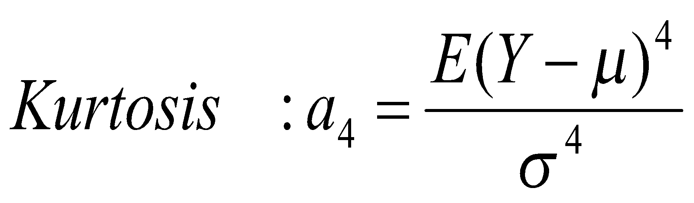
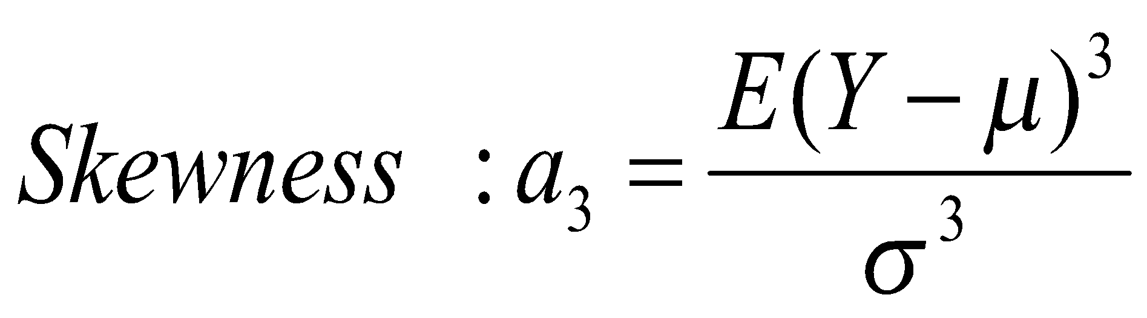
The Shape of Distributions
Measures for skewness and kurtosis
Measures for skewness and kurtosis tell us therfore more about a distribution
Skewness and kurtosis of a normal distributed variable are zero and three, respectively
Skewness:
a₃ > 0 distribution skewed to the right/ positively skewed
a₃ < 0 distribution skewed to the left/ negatively skewed
Kurtosis:
a₄ > 3 thinner tails & higher peak than a normal distribution
a₄ < 3 thicker tails & lower peak compared to a normal distribution
For a meaningful and comparable measure of a4, the distribution should be symmetrical (hence again the need to have a normal distribution)

Slide 146
Measures of Skewness and Kurtosis
A fundamental task in many statistical analyses is to characterize the location and variability of a data set (Measures of central tendency vs. measures of dispersion)
Both measures tell us nothing about the shape of the distribution
A further characterization of the data includes skewness and kurtosis
The histogram is an effective graphical technique for showing both the skewness and kurtosis of a data set

Slide 147
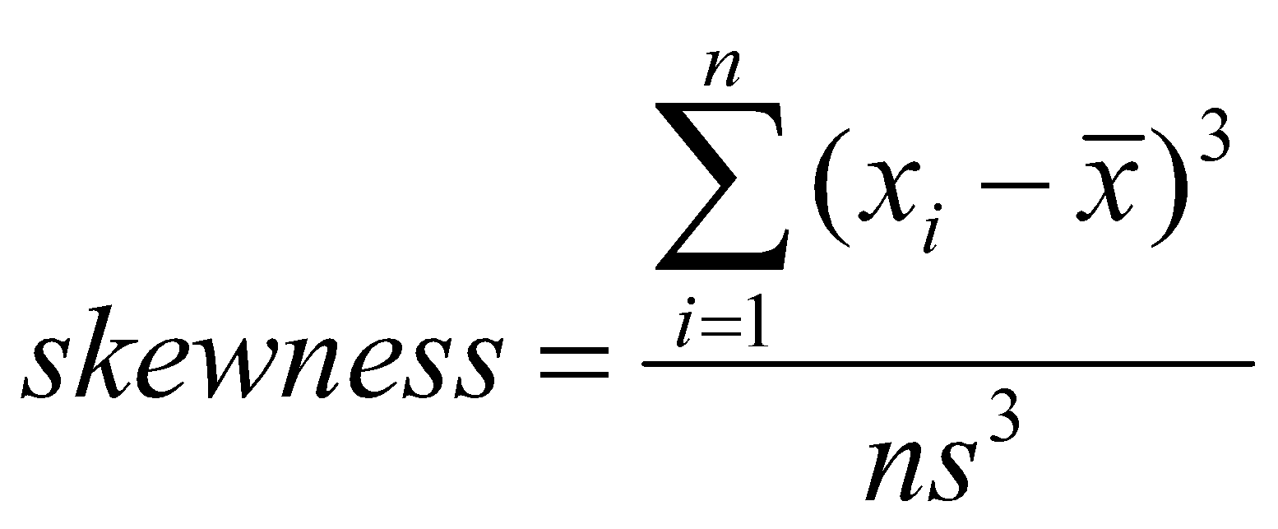
Further Moments – Skewness
Skewness measures the degree of asymmetry exhibited by the data
If skewness equals zero, the histogram is symmetric about the mean
Positive skewness vs negative skewness

Slide 148
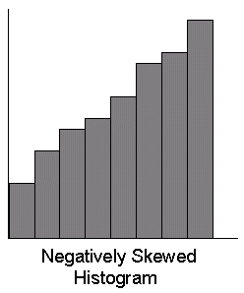
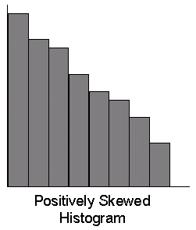
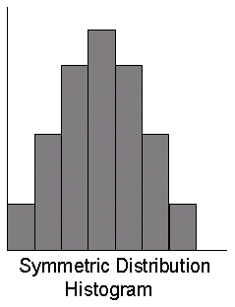
Further Moments – Skewness

Slide 149
Further Moments – Skewness
Positive skewness
There are more observations below the mean than above it
When the mean is greater than the median
Negative skewness
There are a small number of low observations and a large number of high ones
When the median is greater than the mean

Slide 150
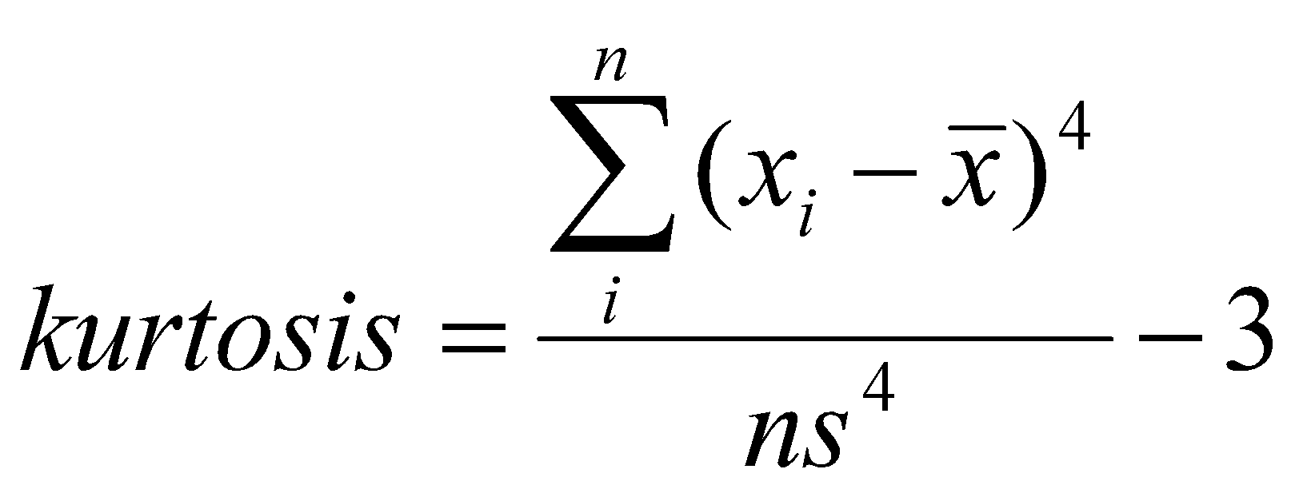
Further Moments – Kurtosis
Kurtosis measures how peaked the histogram is
The kurtosis of a normal distribution is 0
Kurtosis characterizes the relative peakedness or flatness of a distribution compared to the normal distribution

Slide 151
Further Moments – Kurtosis
Platykurtic– When the kurtosis < 0, the frequencies throughout the curve are closer to be equal (i.e., the curve is more flat and wide)
Thus, negative kurtosis indicates a relatively flat distribution
Leptokurtic– When the kurtosis > 0, there are high frequencies in only a small part of the curve (i.e, the curve is more peaked)
Thus, positive kurtosis indicates a relatively peaked distribution

Slide 152
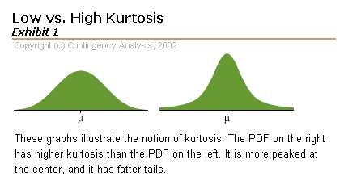
Further Moments – Kurtosis
platykurtic
leptokurtic
Kurtosis is based on the size of a distribution's tails.
Negative kurtosis (platykurtic) – distributions with short tails
Positive kurtosis (leptokurtic) – distributions with relatively long tails

Slide 153

Why Do We Need Kurtosis?
These two distributions have the same variance, approximately the same skew, but differ markedly in kurtosis.
Source: http://davidmlane.com/hyperstat/A53638.html

Slide 154
SAMPLE QUESTIONNAIRE

Slide 155
A soft Drink concentrate manufacturer ( For example Rasna’s Manufacturer) wants to know about the following.
Demographic Profile of users versus non-users of soft drink concentrates.
Among Users.
a) the preference of liquid concentrate Vs Powder
b) Preference for powder with sugar added , versus power with no added sugar
c) Occasion of use by self
d) Whether served to Guests
e) Rating on convenience , taste ,price and availability
f) Brand Preferred among soft drink concentrates.
3) Among Non-Users
Reasons for not using soft drink concentrate.
Substitute product usage if any and reasons for using or consuming them.

Slide 156
Topic- A study of consumer’s perception of Soft Drinks Concentrates with special reference to Rasna- A study in Pune.

Slide 157
Date------
Dear Sir/Madam,
We the students of PG-DABA ,are doing a brief survey to find out more about consumer preference regarding soft drink concentrate. We would be grateful if you could spare a few minutes to participate in it. Thank you for your cooperation.

Slide 158
Continued….
1) Do you use soft drink concentrate to make your own soft drinks at home?
Yes [ ] No [ ]
If Yes , continue with Q2 . If No, Go to Q.9.
Do You use liquid or powdered concentrate ? ( Tick only one)
Liquid [ ]
Powder [ ]
Both [ ]

Slide 159
3) Which Type of concentrate do you prefer out of the followings?
concentrate with sugar added [ ]
Concentrate without Sugar added [ ]
4) What are the occasions when you use soft drink concentrate to make soft drinks?
Regularly , all year round [ ]
Regularly , only in Summer [ ]
Occasionally , all year round [ ]
Occasionally , only in Summer [ ]

Slide 160
5) Do You Serve it to Guests
Yes [ ] No [ ] Depends on Guests [ ]
6) Which Brand do you Use.
Rasna [ ] Brand X [ ] Brand Y [ ]
Any Other Plz Specify -----------
7) Please rate the brand you use on the following attributes on a scale of 1 to 7 (7 = Very Good , 1= Very Poor)
Parameters | 1 | 2 | 3 | 4 | 5 | 6 | 7
Availability
Taste
Convenience
Price

Slide 161
8) Any other comments on the brand use?
After Q.8 Go to Demographics Q.11.

Slide 162
Non- users
9) Do you consume any of the following regularly ? ( you may tick more than one)
Fruit Juice Yes [ ] No [ ]
Bottled Soft Drinks [ ] [ ]
Tea [ ] [ ]
Coeffee [ ] [ ]
Nimbu Pani [ ] [ ]
Butter Milk [ ] [ ]
Other plz specify --------------------------------

Slide 163
10) What are the reasons for not using soft drink concentrate? ( You Can Tick More than One)
Does not Taste Good [ ]
Expensive [ ]
Chemical Additives [ ]
Does not contain natural fruit Juice [ ]
Not Available Easily [ ]
No Nutritional Value [ ]
Any other Pllz Specify :

Slide 164
Demographic Variables
Demographics- Please let us know a little more about yourself.
11.) Your age group
Less than 25 [ ]
26-40 [ ]
41-50 [ ]
Over 50 [ ]

Slide 165
12.) Your monthly household income
Less than 5000 rupees/month [ ]
5001 to 10,000 rupees/ month [ ]
10,001 to 15,000 rupees / month[ ]
Over 15,000 rupees/month [ ]
13.) Address
THANK YOU

Slide 166
TOPIC-?

Slide 167
Topic- A study on consumer buying behaviour and effect of promotional activities of the SONY range of CTV.

Slide 168
Questionnaire for consumer
Date- Q.N0.-----
Dear Sir/Madam,
We the students of PG-DBDA are conducting a market research to know your brand perception in the color TV segment. Kindly extend your cooperation in filling this Questionnaire and enable us in doing the research successfully.

Slide 169
Questionnaire for Consumer
Are you a user of Sony colour television?
[ ] Yes
[ ] No
If no, specify which brand ----------------
2. What influenced your decision to purchase a colour TV(Rank the following in order of preference)- 1- Best, 2- Next Best , and so on.
---Aesthetics/Appearance
--- Price
--- Brand Name
--- Reliability
--- Performance
--- Advertisement
----After Sales Service
---- Others

Slide 170
3) What influenced your decision to purchase/ not to purchase (Plz tick one purchase or not purchased) Sony Colour Tv?
(Plz Select any Two from Above)
i----------------------
Ii---------------------
4) Which Brand do you think is the toughest competitor to Sony?
[ ] Onida
[ ] Videocon
[ ] LG
[ ] Philips
[ ] Akai
[ ] Samsung
[ ] Aiwa
If any other Specify-----------------
Why that Brand?

Slide 171
5) Do you think sony colour TV is a
[ ] Successful Brand
[ ] Unsuccessful Brand
6) Why do you think Sony Colour TV has been a successful brand/Unsuccessful Brand (Plz tick One) ?
[ ] Range of the Products
[ ] Range of Prices
[ ] Promotional Activities
Any Other Plz Specify-----------?

Slide 172
7.) Based on the price range what impression do carry of Sony CTV?
[ ] Economical
[ ] Costly
8) Tick the size of Sony Colour TV you Own( Only user’s Question)?
[ ] 14” [ ] 20” [ ] 21’’ [ ]25’’ [ ] 29’’

Slide 173
9) Which of the following attributes do you perceive as most important in your colour Tv?
[ ] Net Savvy Technology (Web TV, Multi-Media TV etc.)
[ ] Locking Systems (eg Child Lock , Volume Lock)
[ ] Picture in Picture
Any other , Specify?

Slide 174
10) What do you think of the advertisement of Sony?
[ ] Impressive
[ ] Satisfactory
[ ] Unsatisfactory
You like/ dislike the advertisement because of:
[ ] Model /Celebrity Like Dislike
Specify the Celebrity ----------- ---------------
[ ] Presentation
What you liked/disliked ----------- ----------------
[ ] Slogan ------------ ----------------
Any other (Specify )

Slide 175
12) Which do you think is the most striking media to advertise Sony CTV?
[ ] Newspaper
[ ] Magazines
[ ] TV
[ ] The Internet
[ ] Hoarding
[ ] Radio
Other Specify?

Slide 176
13) Do the various schemes/ promotional activities affect your purchase plans?
[ ] Yes
[ ] No
14) If you go for re-purchase of TV , will you prefer Sony Colour TV? (For Non-Users)
[ ] Yes
[ ] No
15. Do you agree or disagree with the punch line of Sony- [ ] Yes [ ]
Reason Why?

Slide 177
A word About Yourself
Name:
Address:
Age- (a) 18-25 (b) 26-30 (c) 31-40 (d) Above 40
Occupation- Student/Service/Business/Any other Specify---------------------
Gender: Male [ ] Female [ ]
Annual Income- 1) < 100000
2) 100000-150000
3) 150001- 200000
4) 200001-250000
5) 250001-300000
6) > 300000

Slide 178
Questionnaire for Dealers/Retailers
Date- Q.N0.-----
Dear Sir/Madam,
We the students of PG-DBDA are conducting a market research to know Customer’s brand perception in the color TV segment. Kindly extend your cooperation in filling this Questionnaire and enable us in doing the research successfully.

Slide 179
1) . What influences your consumer ‘s decision to purchase a Sony colour TV(Rank the following in order of preference)- 1- Best, 2- Next Best , and so on.
---Aesthetics/Appearance
--- Price
--- Brand Name
--- Reliability
--- Performance
--- Advertisement
----After Sales Service
---- Others

Slide 180
2) Which size of Sony Colour TV do the customers purchase the most
[ ] 14” [ ] 20” [ ] 21’’ [ ]25’’ [ ] 29’’
3) Which Brand do you think is the toughest competitor to Sony?
[ ] Onida
[ ] Videocon
[ ] LG
[ ] Philips
[ ] Akai
[ ] Samsung
[ ] Aiwa
If any other Specify-----------------
Why that Brand?

Slide 181
4) Where do you rank the following colour TVs in terms of (Rank the top 3 for Each)
Brand Name/Attributes | SONY | ONIDA | LG | VIDEOCON | AIWA | AKAI | SAMSUNG
Aesthetics
R -Products
R-Prices
Performance
DPA
CPA
ASS

Slide 182
5) Do You think Sony Colour TV is a
[ ] Successful Brand
[ ] Unsuccessful Brand
6) Why do you think Sony Colour TV has been a successful brand/Unsuccessful Brand (Plz tick One) ?
[ ] Range of the Products
[ ] Range of Prices
[ ] Distribution Network
[ ] Promotional Activities
Any Other Plz Specify-----------?

Slide 183
7) Are the customers sales promotional activities of Sony effective?
[ ] Yes
[ ] No
If No why?
8) Are you satisfied with the current media used by Sony for advertisement?
[ ] Yes
[ ] No

Slide 184
9) If No, Which do you think is the most striking media to advertise Sony CTV?
[ ] Newspaper
[ ] Magazines
[ ] TV
[ ] The Internet
[ ] Hoarding
[ ] Radio
Other Specify?

Slide 185
10) Do You think Sony should go for financing the purchase of the colour TV?
[ ] Yes
[ ] No
11) Are you satisfied with the dealer incentive scheme provided to you by Sony ?
[ ] Yes
[ ] No

Slide 186
12) Do you think the latest technological changes introduced in the Sony Colour TV will result a boost in its Sales ?
[ ] Yes
[ ] No
Shop No-
Address
Thank You.

Slide 187
Thank You

